Slide 1
Newspapers/Websites Post List of Gun Owners
Topic A (Good)
Gregory Andres, Gregory Greenleaf, Scott Greenwald, Michelle Meyer, William Nelson, Christian Nieto,
Luke Pederson, Vanessa Ramirez, Daysi Rivas

Slide 2
Problem Definition
A searchable list of gun owners was posted on a blog website for the public to see.
The information had been legally obtained as the NY gun policy states that registered owners' address is to be accessible to the public.
Posting a list of gun owners online is ethical because it allows the public the right of safety and reduction of future violence.

Slide 3
Historical/Legal Content
No laws broken
Info obtained from a Freedom of Information Law request
New York:
"Pursuant to Penal Law Section 400.00(5), the name and address of any person to whom an application for any license has been granted,shall be a public record."

Slide 4
Stakeholders
Residents
Potential homeowners, renters, etc.
Safe neighborhoods
Law enforcement
Safety of gun owners
Business
Gun stores

Slide 5
Competitive Analysis
Constitutional right to freedom of speech and freedom of the press
Era of openness
Convenient for people who care

Slide 6
Economic Factors
Gawker: more controversial stories, more ad money
Gun shops: for gun owners that don't want to be on list, will they buy a gun legally in the future?
Gun industry: sales reached $12 billion by the end of 2012

Slide 7
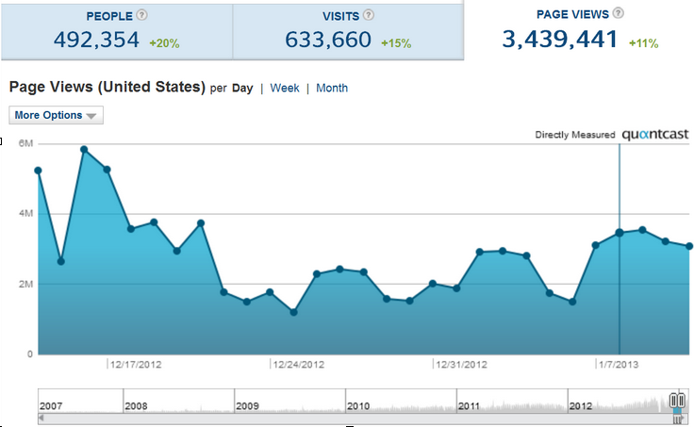
Economic Factors
via quantcast.com

Slide 8
Technological Factors
List already downloadable before incident
More accessible for people already looking
Everything is becoming more digitized
Gather information based on license plate

Slide 9
Recommendations
Keep an online list with restrictions
Not available for the whole public
Potential homeowners, renters, etc.
Background check
Require login to access and time limited access
Provide gun owners option to made their information private

Slide 10
Pros
First Recommendation: Limiting access only to residents
beneficial to concerned residents
beneficial to gun owners
ease of harassments and safety
Second Recommendation: Gun owner opt-out from personal information being released to the public
Law enforcement and Mental Health professionals will have access to this information
Recertify every five years in order to stay compliant with current gun laws

Slide 11
Pros and Cons
Pro - Openness and not secrecy
- Government Accountable
Con - Allowing everyone/anyone to see

